Slide 1
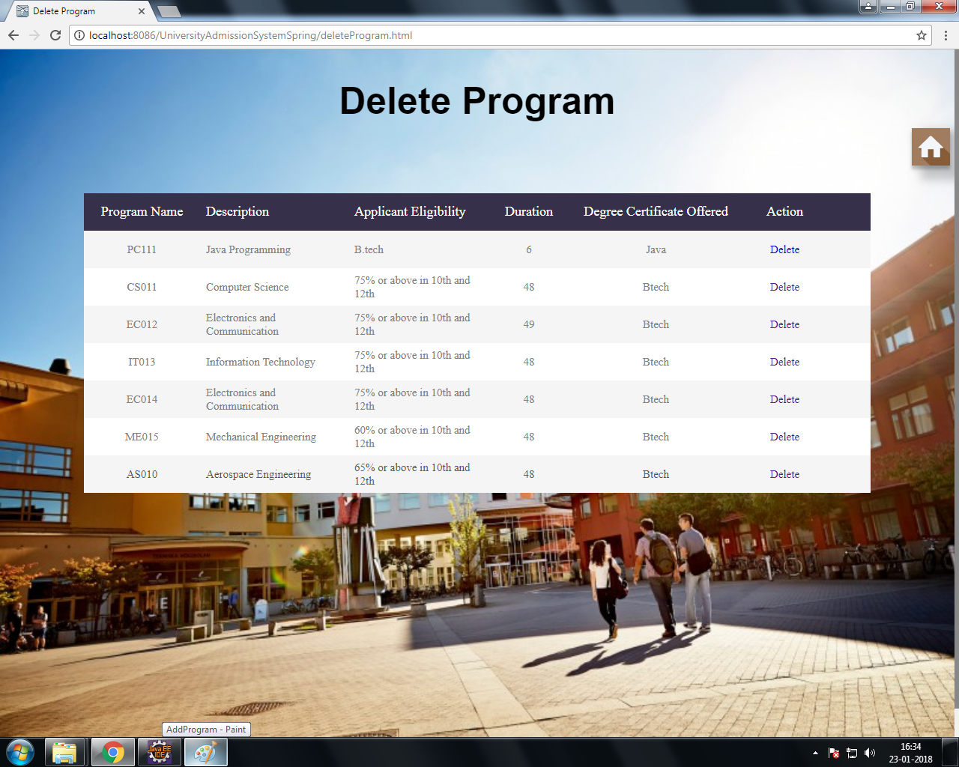

Delete program
Delete the program offered by the university.

Slide 2
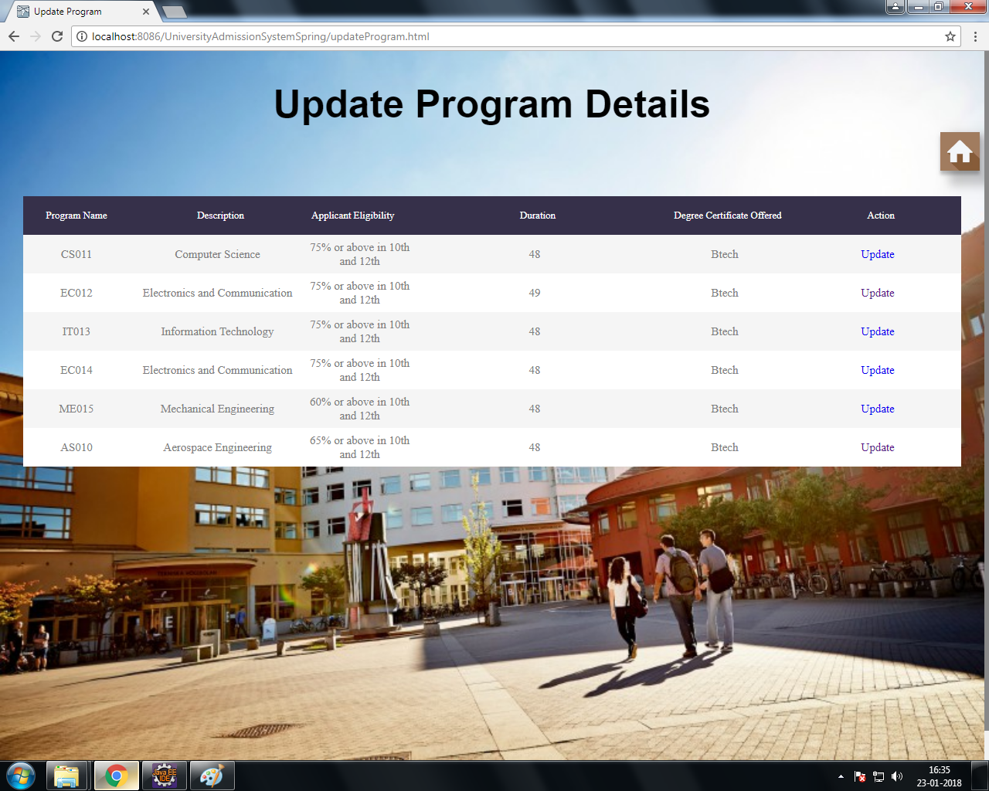
Update program
Update existing program offered by the university

Slide 3
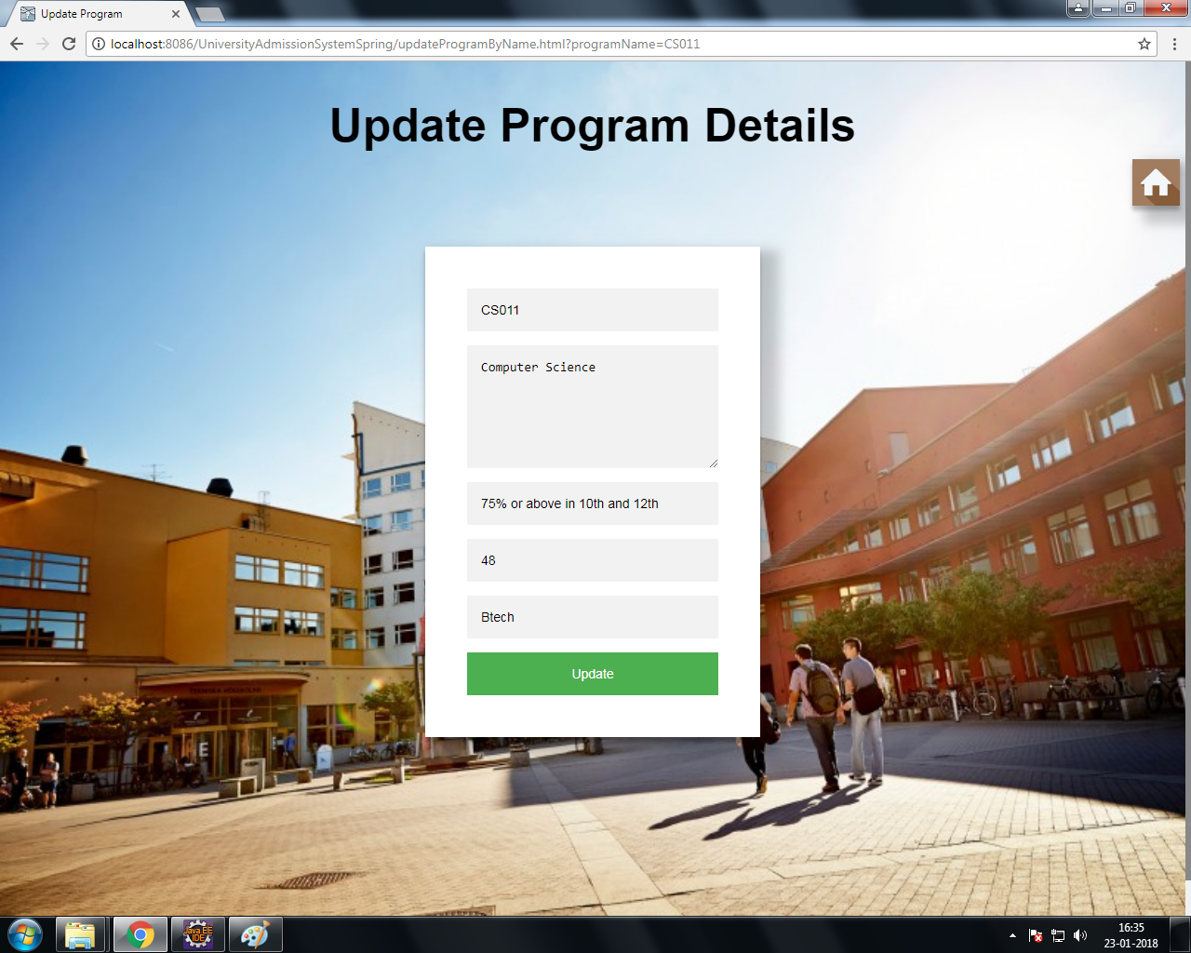

Slide 4
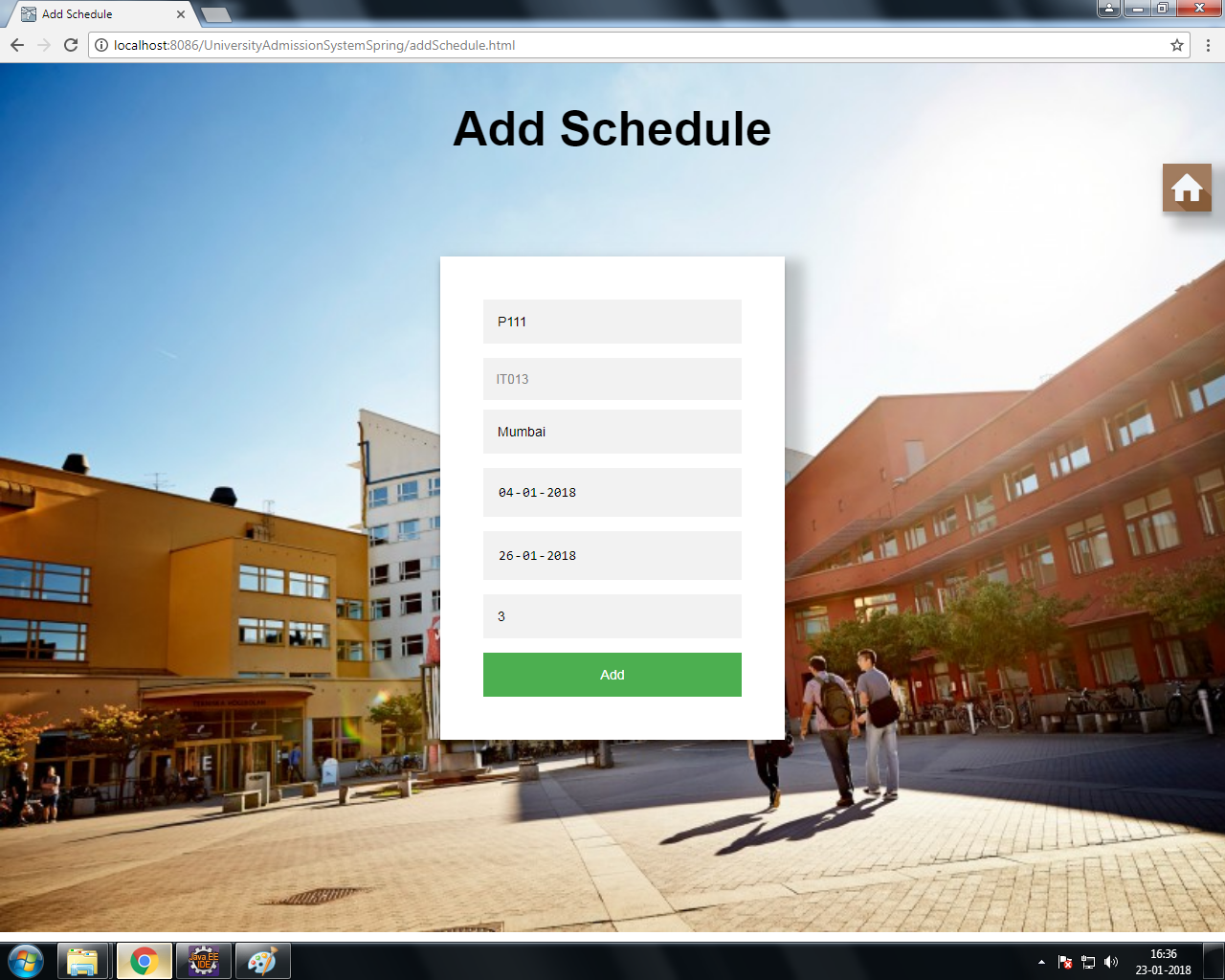
Add schedule
Add schedules of the programs offered by the university

Slide 5
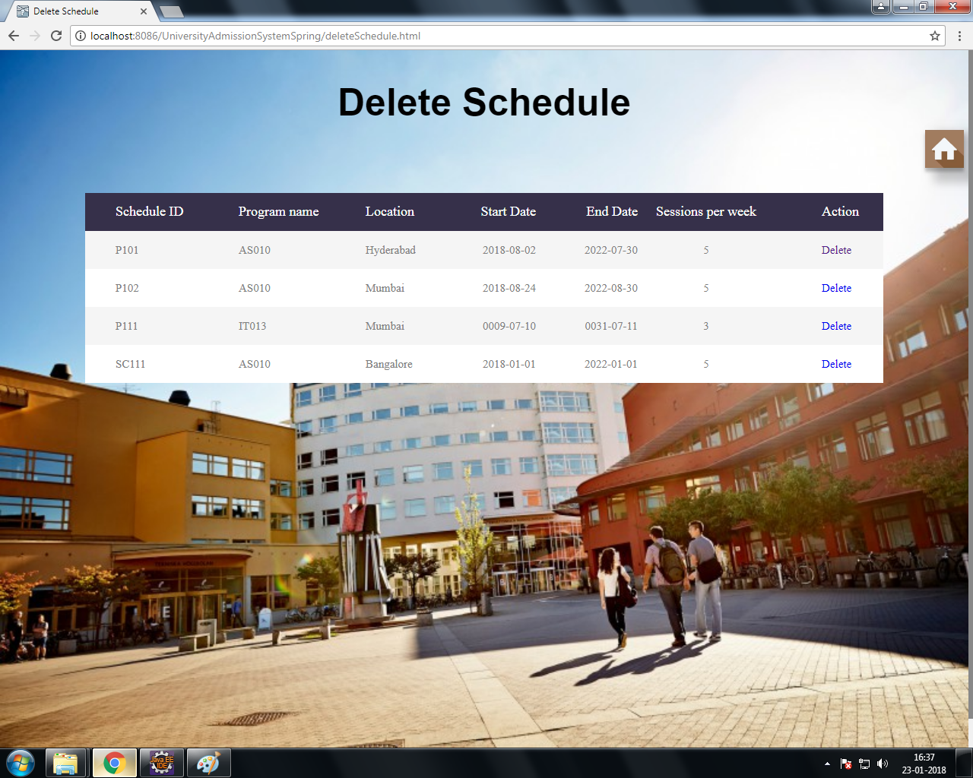
Delete schedule
Delete schedules of the programs offered by the university

Slide 6
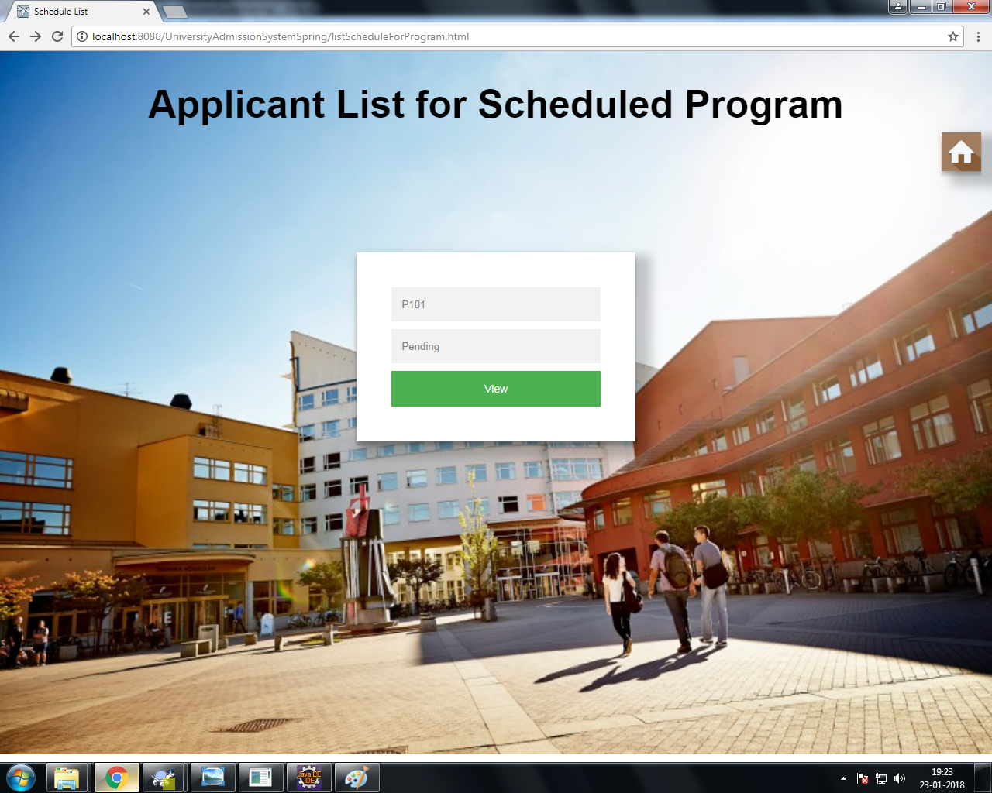
List applicants for a scheduled Program
View List of applicants confirmed/ accepted /rejected for a scheduled program.

Slide 7
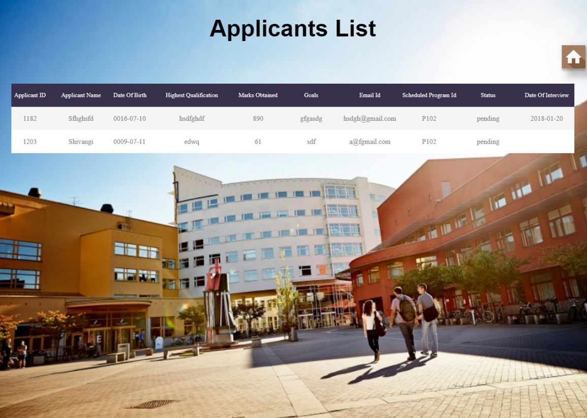

Slide 8
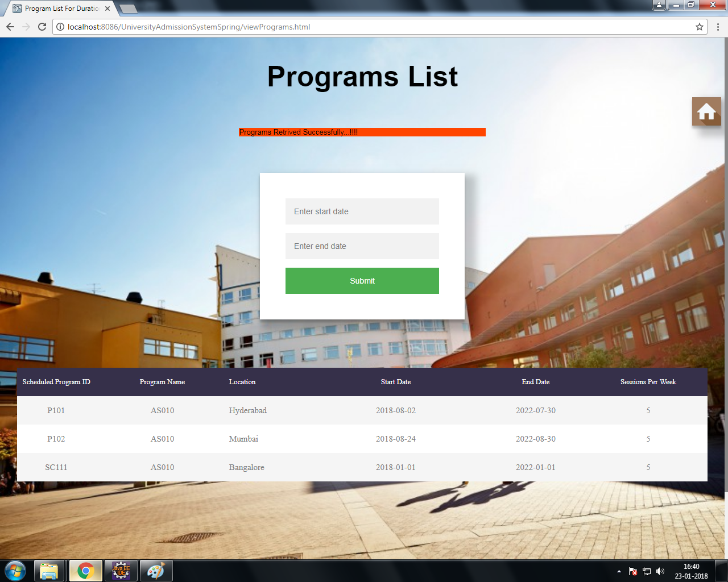
List schedule for a particular time interval
View list of programs scheduled to commence in a given time period

Slide 9
Member of Admission Committee Module

Slide 10
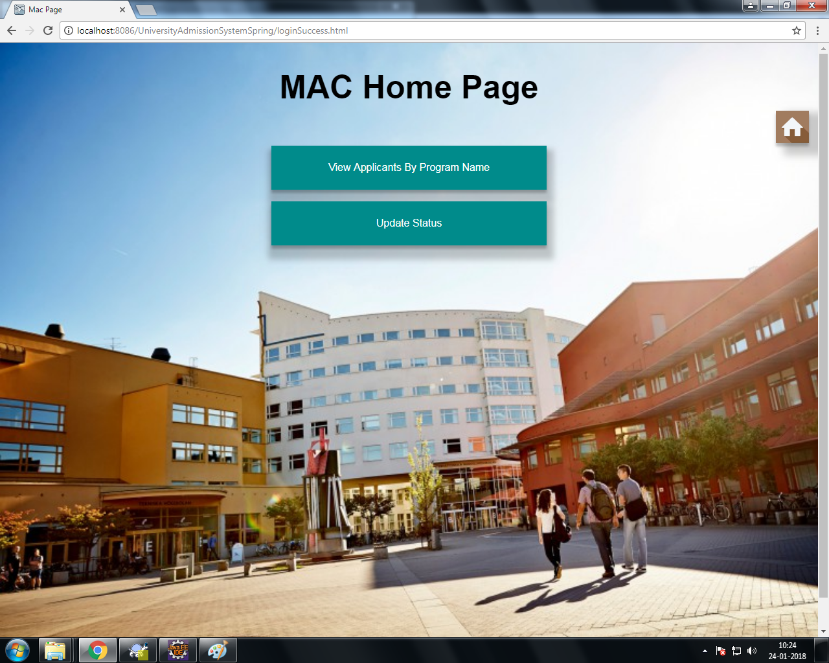
MAC Home Page

Slide 11
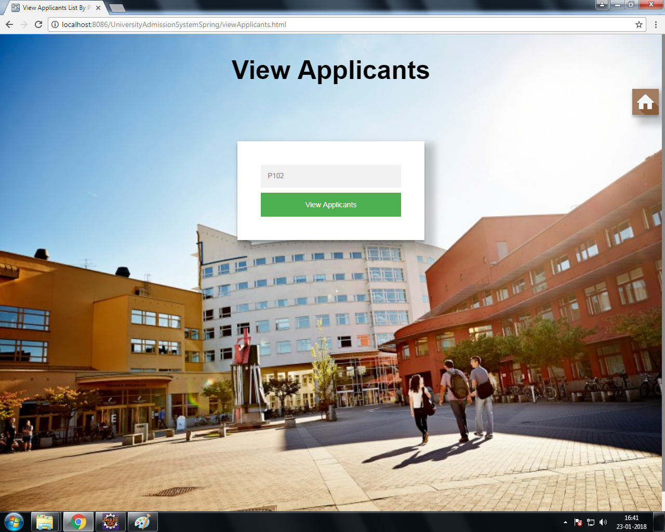
List applicants for particular program
View applications for a specific program

Slide 12
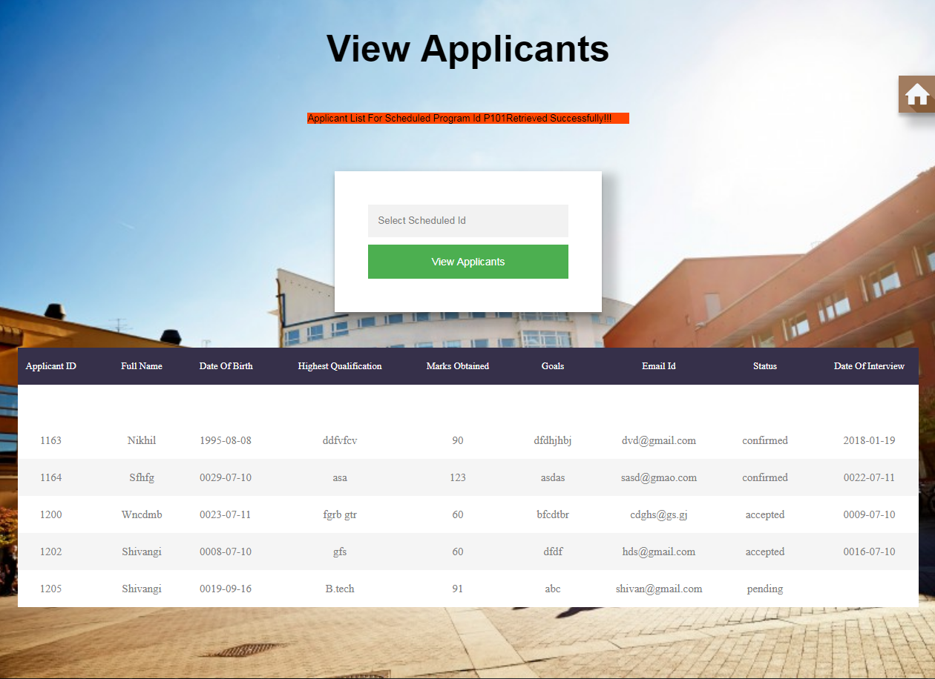

Slide 13
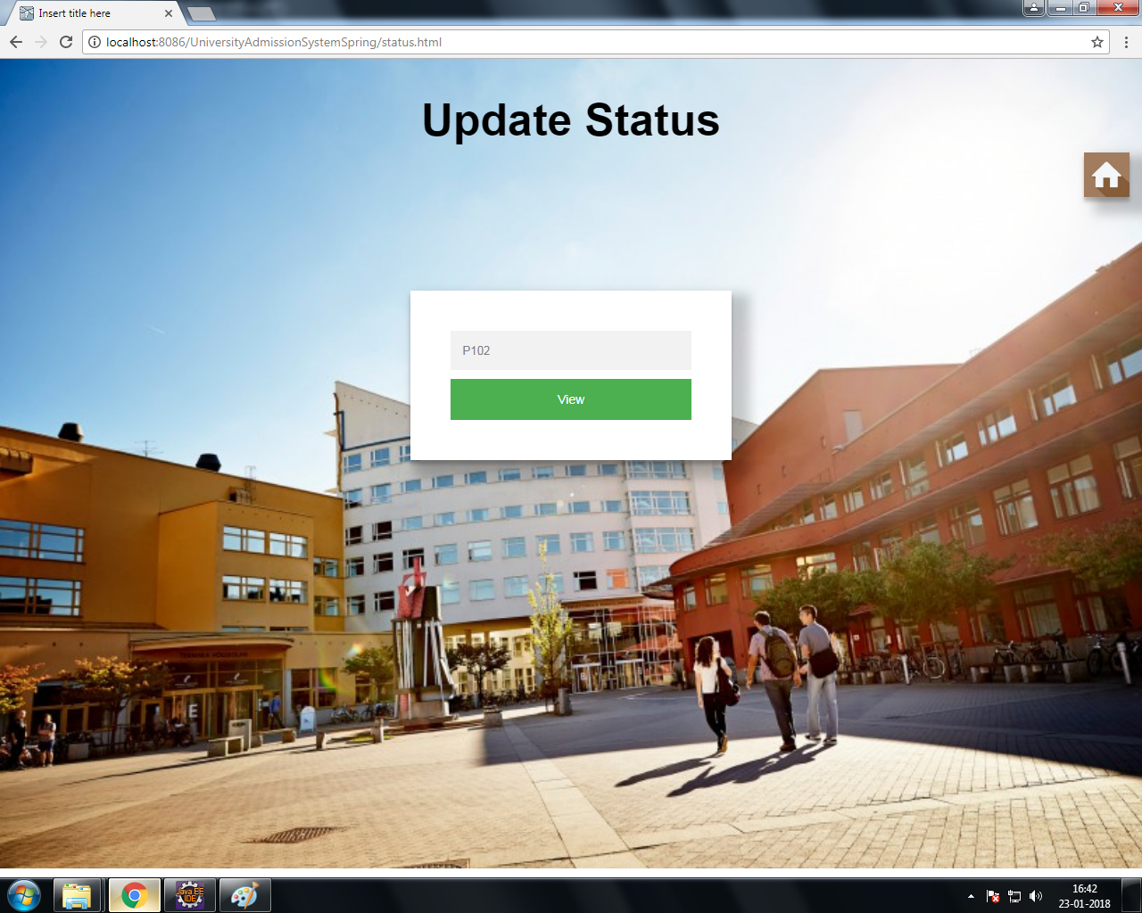
Update status
Accept/Reject an application on the basis of the details of the applicant. If accepted, fill in the scheduled date for an interview of the applicant before confirming the applicant to take the program.

Slide 14
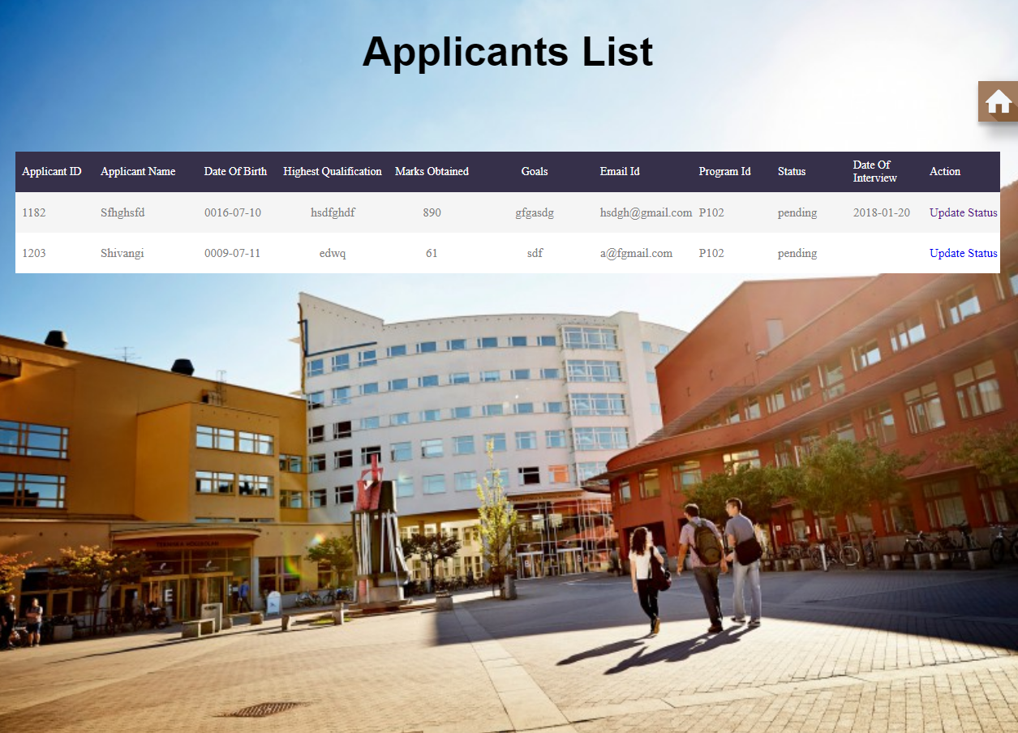

Slide 15
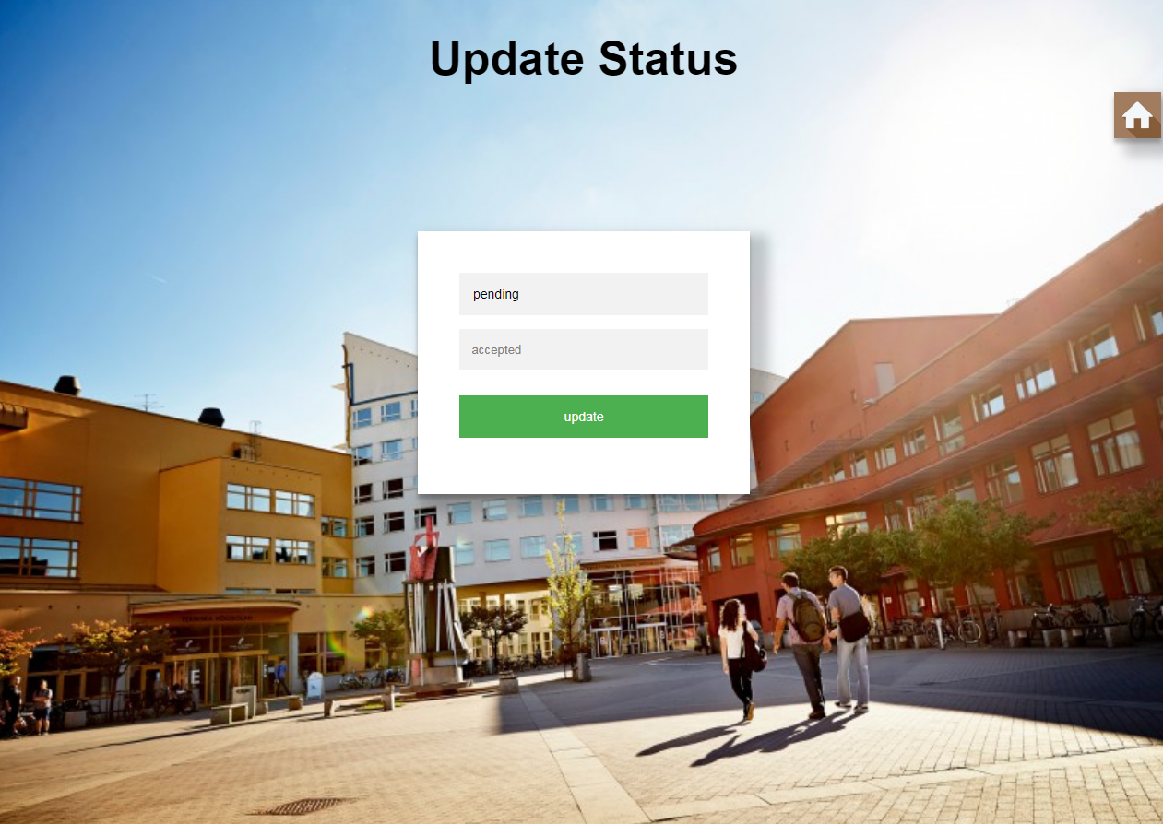

Slide 16
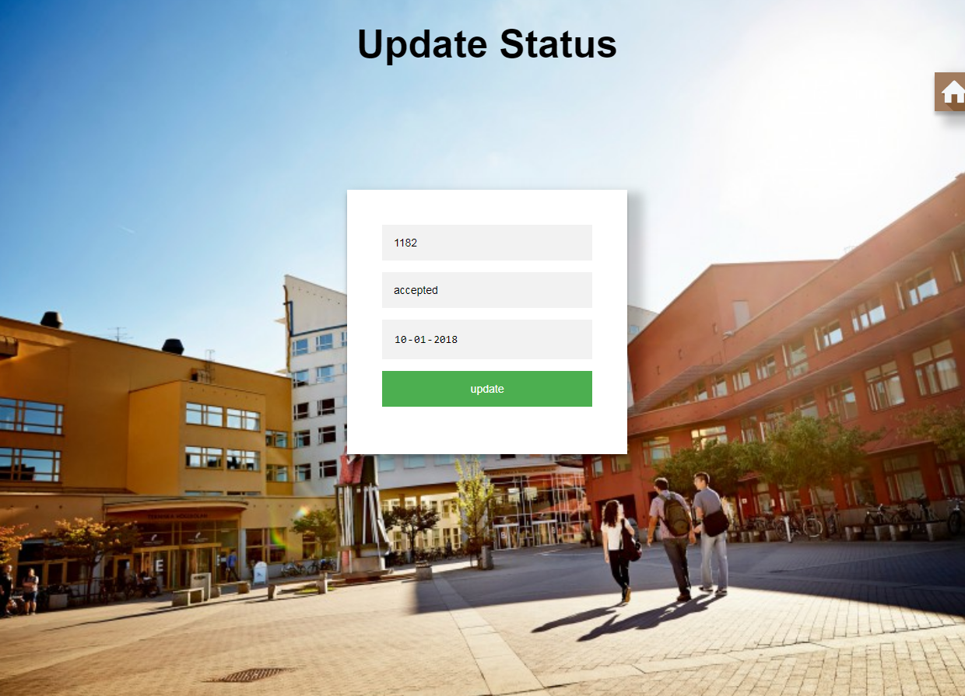

Slide 17


Slide 18
Future Enhancements
To provide live tracking of the application and provide notifications through SMS.
To be able to download reports in multiple formats.
Optimizations.

Slide 19
THANK YOU

